Slide 1

Exoplanets – Aliens?

Slide 2
Circular Motion, the Planets, and Gravity

Slide 3
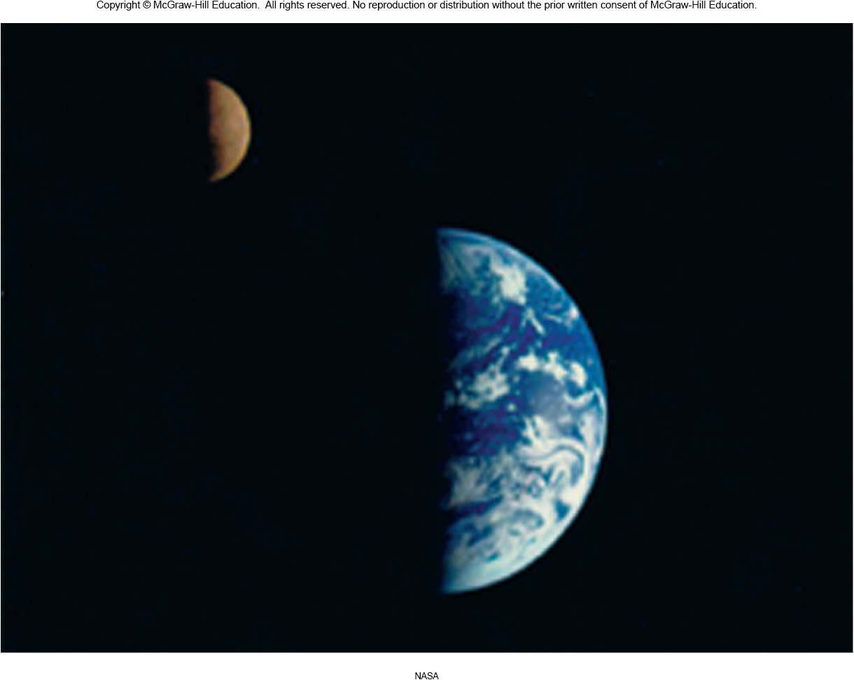
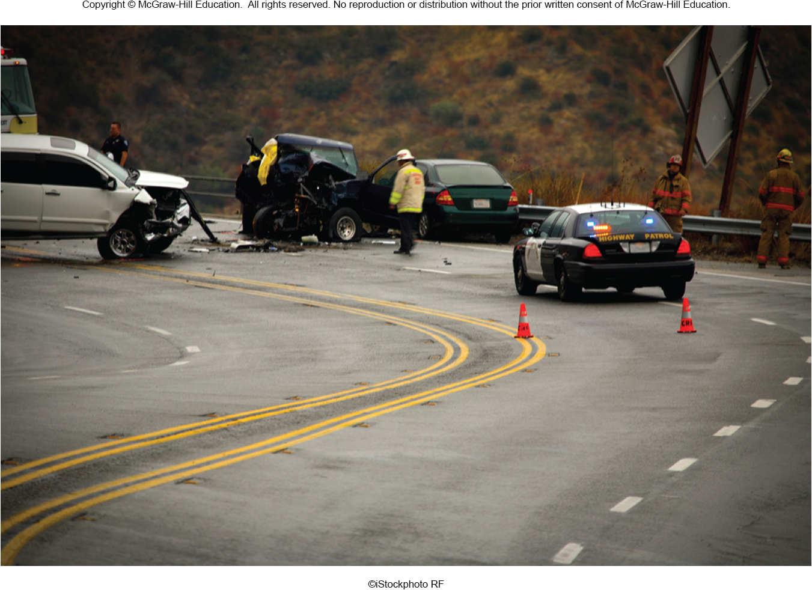
Does the circular motion of the moon around the Earth ...
... have anything in common with circular motion on Earth?

Slide 4
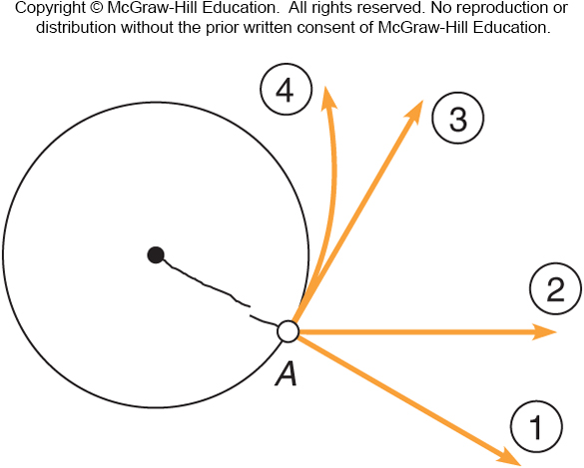
A ball is whirled on the end of a string with constant speed when the string breaks. Which path will the ball take?
Path 1
Path 2
Path 3
Path 4
Path 3, in the direction of the tangent to point A. Neglecting gravity, the body would move in the direction it was moving when the force disappeared, in accordance with the first law.

Slide 5
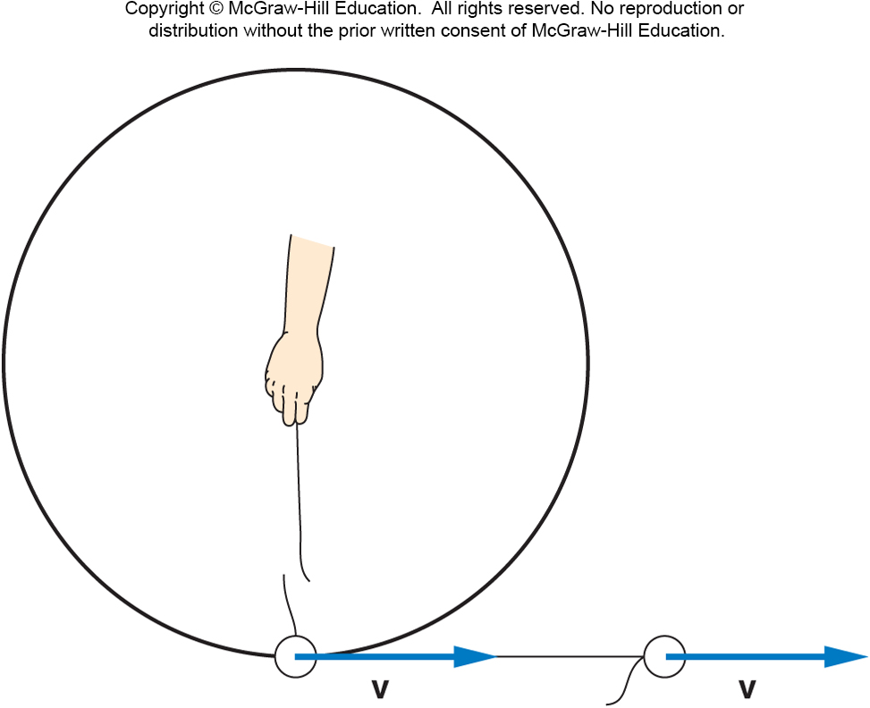
If the string breaks, the ball flies off in a straight-line path in the direction it was traveling at the instant the string broke.
If the string is no longer applying a force to the ball, Newton’s First Law tells us that the ball will continue to move in a straight line.
Circular motion is called centripetal motion, with the string providing a centripetal force.

Slide 6
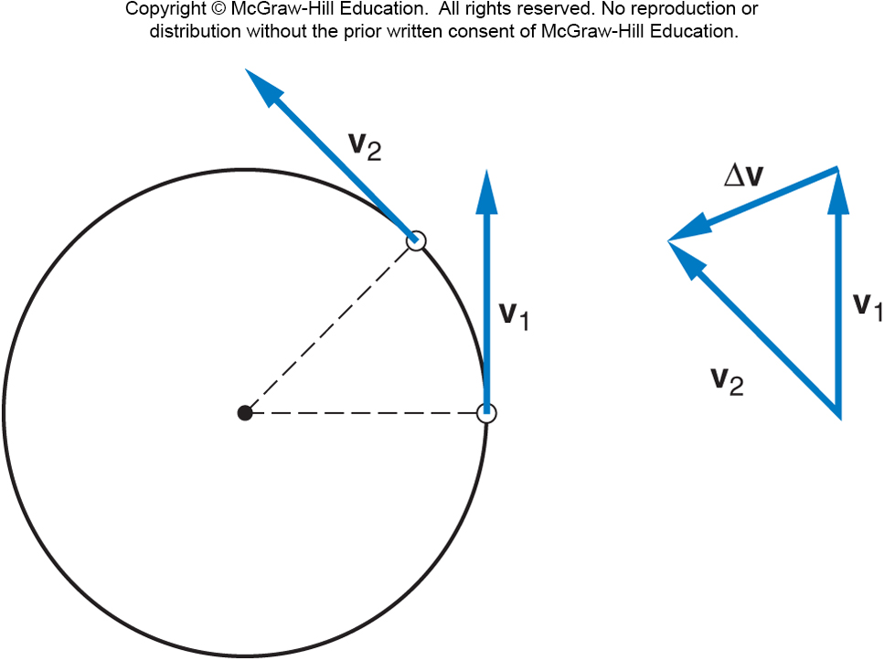
Centripetal Acceleration
Centripetal acceleration is the rate of change in velocity of an object that is associated with the change in direction of the velocity.
Centripetal
acceleration is
always
perpendicular to
the velocity.
Centripetal
acceleration always
points toward the
center of the curve.

Slide 7
Centripetal Acceleration
Centripetal acceleration is the rate of change in velocity of an object that is associated with the change in direction of the velocity.
Centripetal acceleration is always perpendicular to the velocity.
Centripetal acceleration always points toward the center of the curve.
Centripetal acceleration changes direction not speed.
The centripetal force refers to any force or combination of forces that produces a centripetal acceleration.

Slide 8
Centripetal Forces
The centripetal force is the total force that produces a centripetal acceleration.
The centripetal force may be due to one or more individual forces, such as a normal force and/or a force due to friction.
The Static force of friction is the frictional force acting when there is no motion along the surfaces.
No skidding or sliding
The Kinetic force of friction is the frictional force acting when there is motion along the surfaces.

Slide 9
Flat Earth Theory

Slide 10

Foucault’s Pendulum

Slide 11
The Scientific Revolution

Slide 12
Planetary Motion
The ancient Greeks believed the sun, moon, stars and planets all revolved around the Earth.
This is called a geocentric view (Earth-centered) of the universe.
This view matched their observations of the sky, with the exception of the puzzling motion of the wandering planets.

Slide 13
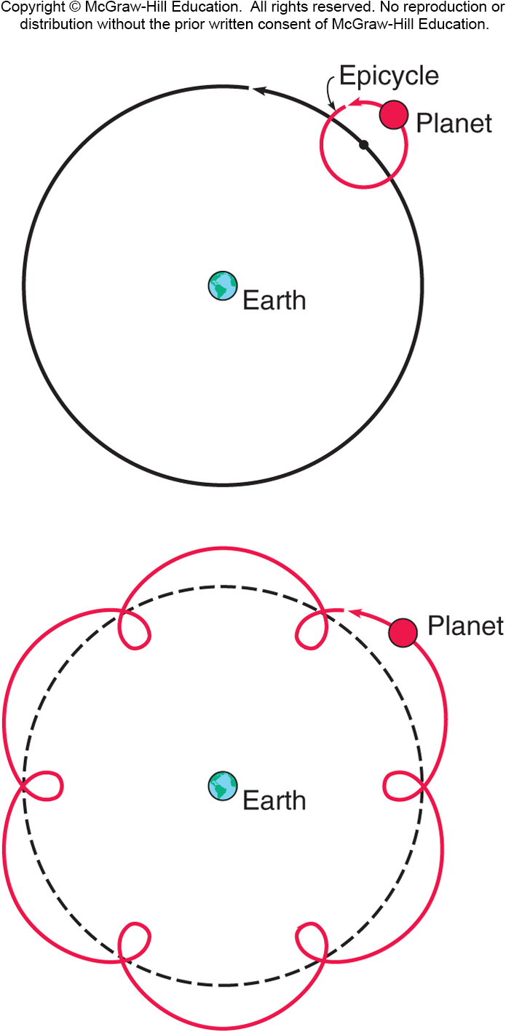
To explain the apparent retrograde motion of the planets, Ptolemy invented the idea of epicycles.
Retrograde motion occurs in a planet’s orbit when the planet appears to move against the background of stars
Epicycles are imaginary circles the planets supposedly travel while also traveling along their main (larger) orbits around the Earth.
This would explain the occasional “backward motion” the planets seemed to follow.

Slide 14
Retrograde Motion

Slide 15
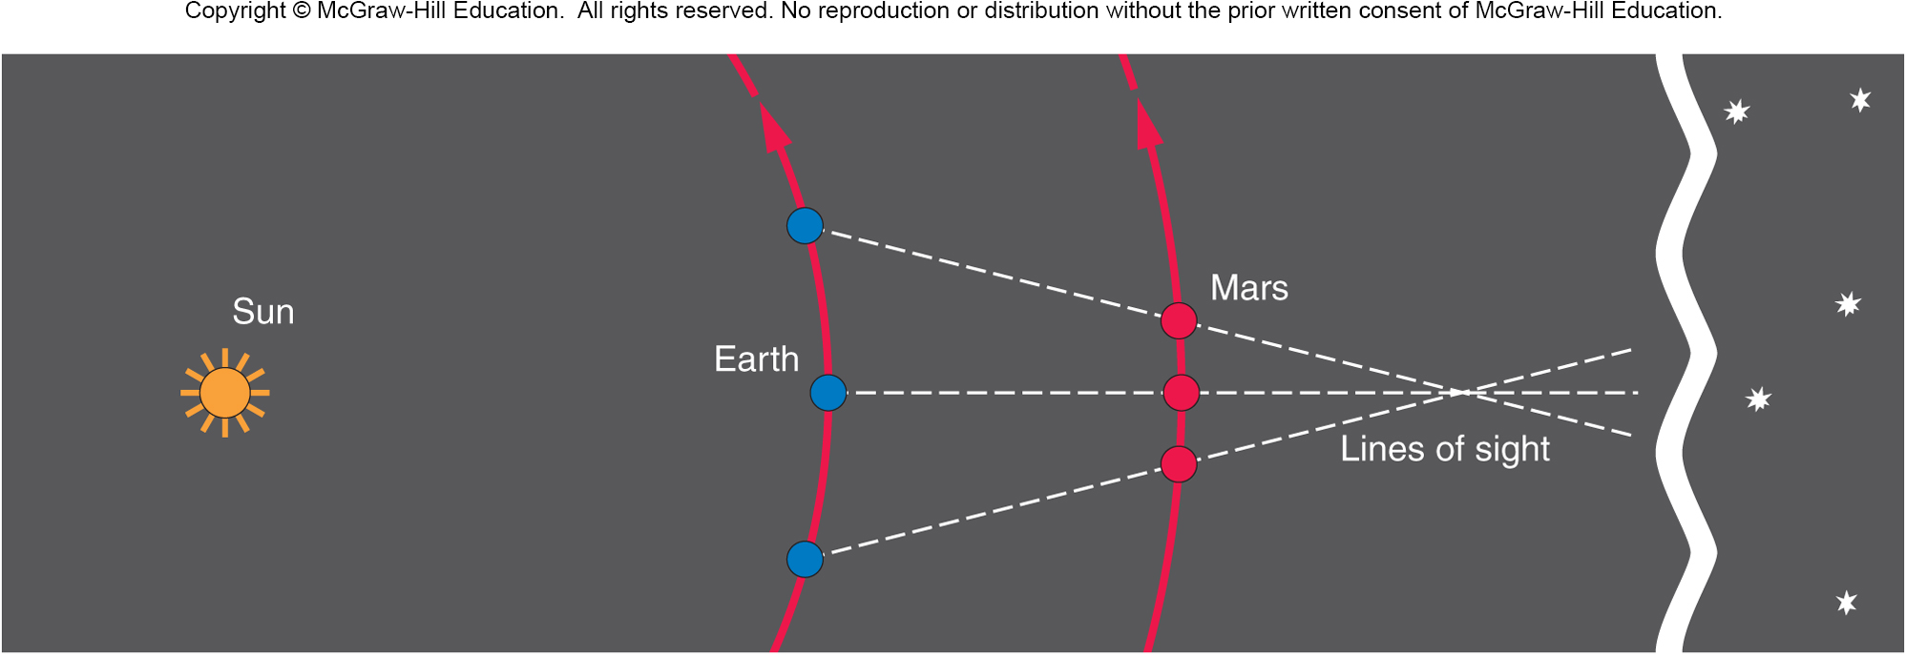
Planetary Motion
With the help of Copernicus, Brahe, and Kepler we now know the best explanation of retrograde motion is simply planetary alignment against an apparently motionless backdrop of stars as planets orbit the Sun.

Slide 16
Copernicus developed a model of the universe in which the planets (including Earth!) orbit the sun.
This is called a heliocentric view (sun-centered) of the universe.
Careful astronomical observations were needed to determine which view of the universe was more accurate.
Tycho Brahe spent several years painstakingly collecting data on the precise positions of the planets
This was before the invention of the telescope!

Slide 17
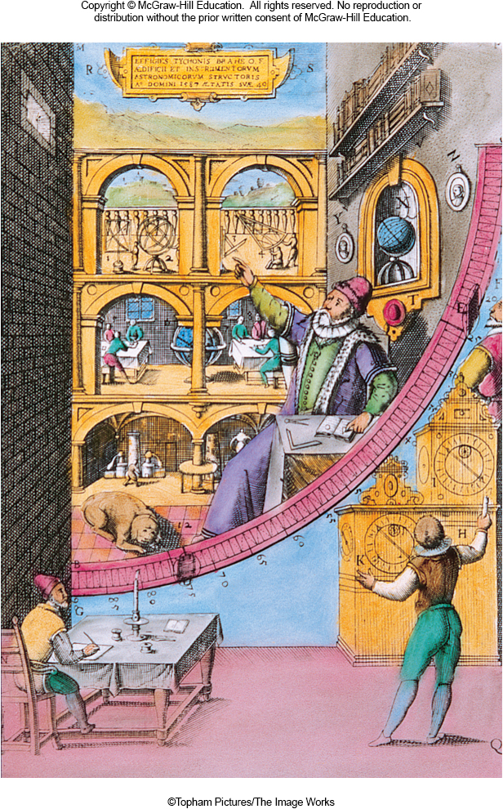
Tycho Brahe’s large quadrant permitted accurate measurement of the positions of the planets and other heavenly bodies.

Slide 18
Tycho Brahe

Slide 19
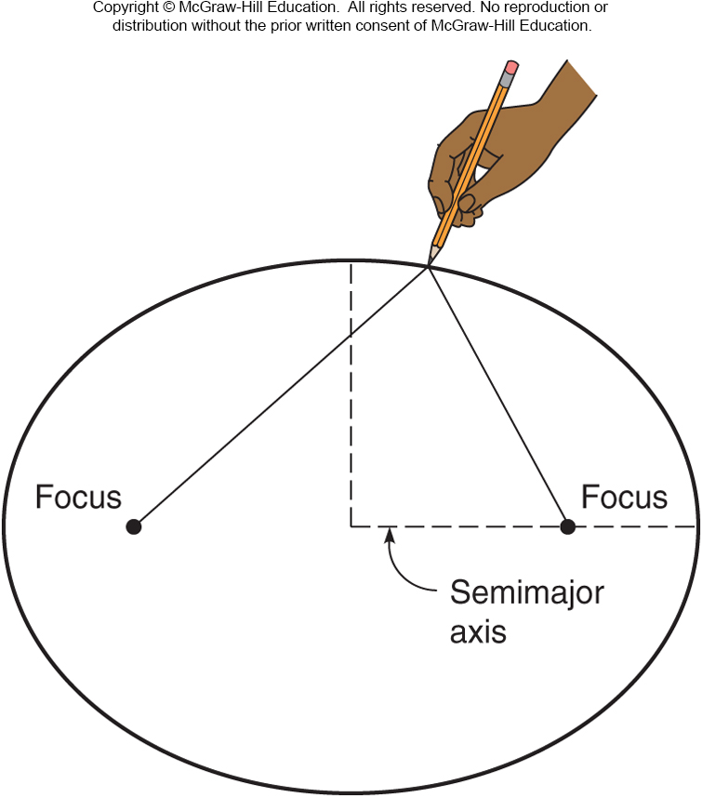
Kepler’s First Law of Planetary Motion
Tycho’s assistant, Kepler, analyzed the precise observation data.
Kepler was able to show that the orbits of the planets around the sun are ellipses, with the sun at one focus.
This is Kepler’s first law of planetary motion.

Slide 20
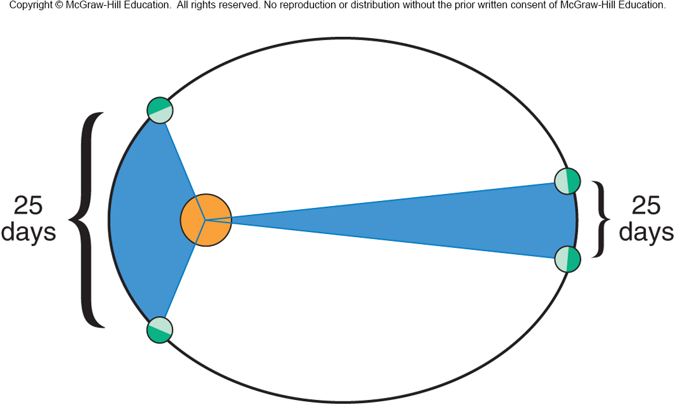
Kepler’s Second Law of Planetary Motion
Because planets move faster when nearer to the sun, the radius line for each planet sweeps out equal areas in equal times.
The two blue sections each cover the same span of time and have equal area.

Slide 21
Kepler’s Third Law of Planetary Motion
The period (T) of an orbit is the time it takes for one complete cycle around the sun.
The cube of the average radius (r) about the sun is proportional to the square of the period of the orbit.

Slide 22
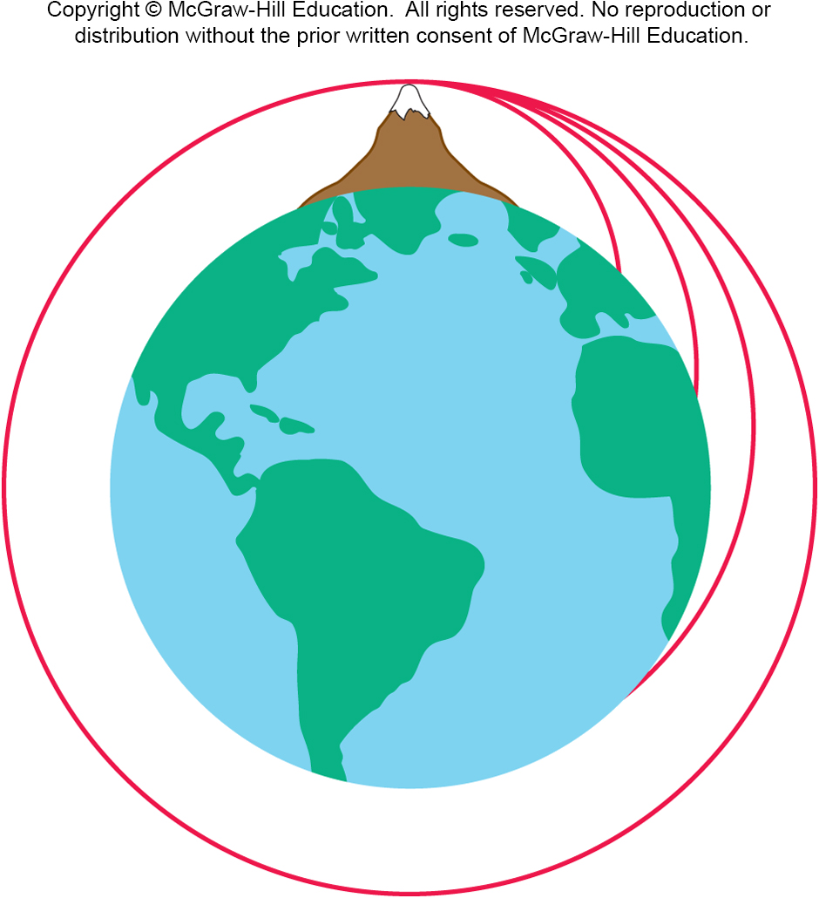
Newton’s Law of Universal Gravitation
Newton recognized the similarity between the motion of a projectile on Earth and the orbit of the moon.
He imagined if a projectile was fired with enough velocity, it would fall towards Earth but never reach the surface.
This projectile would be in orbit.

Slide 23
Newton’s Law of Universal Gravitation
Newton was able to explain Kepler’s 1st and 3rd laws by assuming the gravitational force between planets and the sun falls off as the inverse square of the distance.
Newton’s law of universal gravitation says the gravitational force between two objects is proportional to the mass of each object, and inversely proportional to the square of the distance between the two objects.
G is the Universal gravitational constant G.

Slide 24

Three equal masses are located as shown. What is the direction of the total force acting on m₂?
To the left.
To the right.
The forces cancel such that the total force is zero.
It is impossible to determine from the figure.
There will be a net force acting on m₂ toward m₁. The third mass exerts a force of attraction to the right, but since it is farther away that force is less than the force exerted by m₁ to the left.

Slide 25
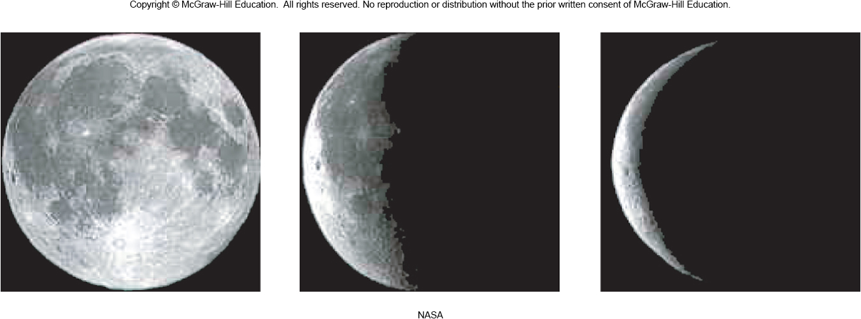
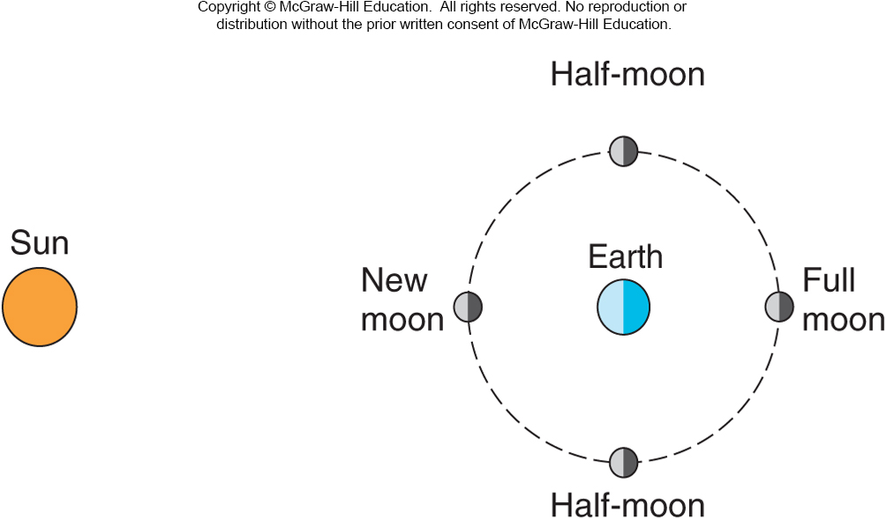
The Moon and Other Satellites
Phases of the moon result from the changes in the positions of the moon, Earth, and sun.

